Slide 1
Attention, transformers and caveats
Embeddings preview, attention, transformers, BERT, GPT, caveats

Slide 2
Exam details
Max. page limit:
10 pages for one student
20 pages in a group of three students
25 pages in a group of four students
Standard page is 2,400 keystrokes including spaces
.ipynb format, report your character count (we’ll tell you how)

Slide 3
Exam details
Two types of questions:
open-ended writing questions
one is about the methods in an unseen a piece of reading
coding question(s) based on unseen data
Grading accounts for:
group size/amount of space you have
ambition

Slide 4
Embeddings preview
Notes:
It might seem strange that we're introducing embeddings now in a hurry, because we need them to explain attention and transformers. But my feelings is that the buildup from RNNs and LSTMs to attention models and transformers is very logical, so I didn't want to interrupt that with a word embeddings lecture. So, we'll be returning to word embeddings next class, and introduce the models and tasks that we typically use to generate pre-trained word embeddings. They will seem very simple to you in comparison to what we are doing here. :)

Slide 5
Embeddings preview
How do we actually feed words into models, in the form of numbers?
Answer: embeddings
Many-dimensional vectors summarizing the meaning of each word
Notes:
So each word corresponds to a list of, say, 200 or 300 numbers

Slide 6
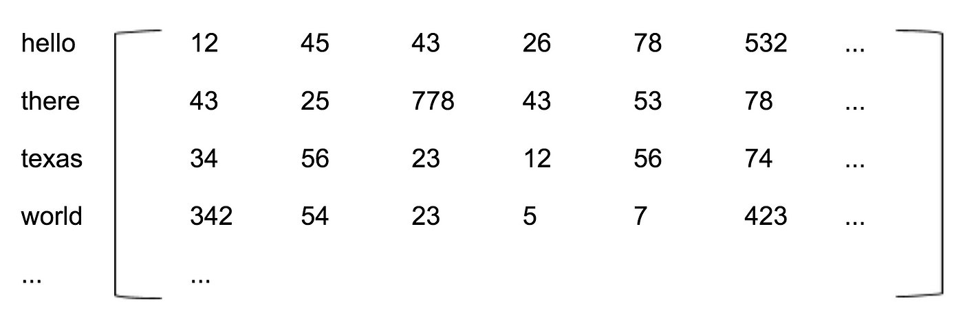
Notes:
This is a so-called embedding matrix. Each row shows a word. The dimensions of such a matrix sometimes have an interpretable meaning. For example, the last column we see could be for meaning related to coding—both “hello” and “world” score high. So the thing to keep in mind for now is that words take on the form of lists of numbers, where certain dimensions (so places in the list of numbers) might be interpretable, and as a whole the lists capture the meaning of the words.

Slide 7
Self-attention
Credits:
Alammar, J. The Illustrated Transformer.
Ng, Andrew. Deep learning specialization. Coursera.

Slide 8
Self-attention
What is self-attention (for)?
It's the ability of a model, when processing one part of an input, to detect and use other relevant parts of that input
Ex. translate from English to French:
"The robber stole all the money from the bank"
Notes:
We’ll keep working with this example and with the task of translation. Later, we’ll get back to what sorts of (other) tasks we actually can do with transformers

Slide 9
Self-attention
"The robber stole all the money from the bank"
"Le voleur a volé tout l'argent de la..."
banque?
bord?
Notes:
Banque is the correct translation of the financial institution, bord is the translation of bank as in river bank. Nothing in RNNs or LSTMs is specifically designed to learn that when a previous word was about theft or money,
we should take that into account when translating "bank". Human translators do this intuitively; they will look back at the sentence and notice the surrounding words that are relevant to translating the current word.

Slide 10
Self-attention
Multiple types of attention mechanisms for neural nets
Here:
Query – key – value attention
Basic idea: weights specialized in learning each of three things about words
Notes:
Mostly, we study this attention mechanism because it is one of the key innovations in so-called transformer models, which we'll cover later today

Slide 11
Self-attention
Queries: the questions that you might ask of the rest of the sentence when you encounter this word for processing
Ex. “bank” leads to the query “what’s happening there?”
Notes:
Exactly how it’s possible to store or learn queries like this in the form of numbers, we will get back to in a bit.

Slide 12
Self-attention
2. Keys: the queries that this word could answer, if those queries were being asked on behalf of other words in the sentence
Ex. “stole” is good at answering the query “what’s happening there?”
Notes:
So, if there’s another word in the sentence that’s looking around for help understanding “what is happening”, perhaps because it looks like a place and we need help understanding what kind of place that is, then “stole” will hopefully light up as a very good answer to that.

Slide 13
Self-attention
3. values: the answers (to queries) contained in the word
(basically, another smaller embedding)
Ex. “stole” contains meanings such as “valuable”, “taking”, “crime” and so on

Slide 14
Self-attention
So, if we learn the right
queries associated with “bank”
keys associated with “stole”
values associated with “stole”
Then while translating “bank”
we will ask of the rest of the sentence “what’s happening there?”
“stole” will look like a good answer
the answer will score high on meaning dimensions like “value” and “crime”
Notes:
And that answer, of course, will help us decide whether the translation of “bank” should be “banque” or “bord”. Basically, before making the translation, we will add the meanings from the answers to the queries to the meanings associated with the word itself. So instead of having to translate “bank”, we now have to translate “bank plus value, crime, stealing”. If the sentence had been “he was fishing on the river bank”, then the query might still have been “what’s happening there?”, but now “fishing” will look like a good answer. So we’ll end up translating “bank plus water, river, fish”.

Slide 15
Transformers
Credits:
Alammar, Jay. The Illustrated Transformer.
Ng, Andrew. Deep learning specialization. Coursera.
Notes:
https://jalammar.github.io/illustrated-transformer/

Slide 16
Transformers
No more recurrence
Transformers take in sequences, but don't process them sequentially
All parts of the input sequence are taken in at once
For each part (ex. word), self-attention helps us figure out what other parts to consider while processing it

Slide 17
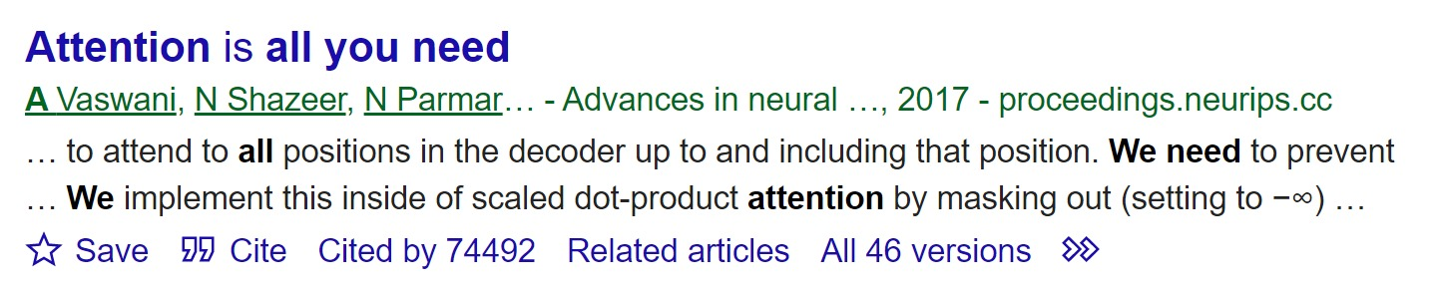
Transformers
Two main innovations:
Query-key-value attention
Multi-head attention

Slide 18
Transformers
Multi-head attention:
Multiple sets of query-key-value weights
So, “bank” might result in several queries:
what is happening there? (answer: stealing)
what objects are found there? (answer: money)
what people are found there? (answer: robber)

Slide 19
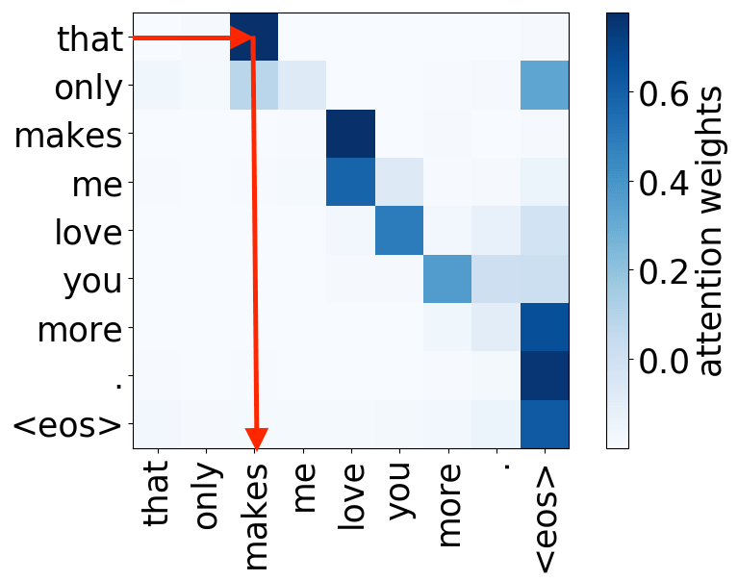
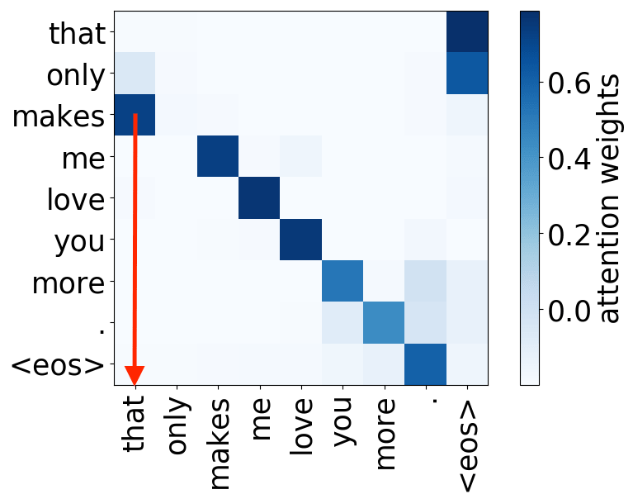
Notes:
Here, we can see the result of two different attention heads, when we apply them to the same input sentence. Dark blue squares mean that when we are processing the word in the row, we are paying a lot of attention to the word in the column. So the first head has learned that when we try to process “that”, we should also look at “makes”—for example, if we are trying to translate “that”, “makes” helps us see that it’s the subject of a sentence, and not (for instance) part of a phrase like “that cat”. The second head has managed to pick up on the fact that when we process “makes” we should also look at “that”—it’ll help us understand that we are looking at a verb here, and not different “makes” of car, for example.

Slide 20

Notes:
Let’s try to go over the components of the transformer architecture. As we go, keep in mind that this architecture was designed for sequence-to-sequence tasks like translation. Inputs: we are feeding a sentence into the model, all at once. The model doesn’t create its output sentence all at once, though. Instead, it get to generate its outputs one by one, and those outputs are fed back into the model so that it also gets to know what it outputted so far. Ultimately, the model is supposed to output probabilities for the next word, so how likely it is that the next word is banque, bord and so on.

Slide 21
Notes:
Before, we saw that sequence-to-sequence models tend to have a component dedicated to taking in the input; that’s the encoder. It ultimately creates an intermediary output that’s supposed to contain all the relevant info from the input, in number form. On the right, we have the decoders, which are trying ultimately to predict the next word based on the encoded input sentence. Transformers use a stack of encoders and a stack of decoders; basically, they just stack the same mini-model on top of each other again and again.

Slide 22

Je suis étudiant
Notes:
This is what is happening inside the first encoder block. The block takes the input sequence, and applies multi-head key-query-value self-attention to it. So in the first encoder block, so every input word is basically augmented with relevant info coming from words around it. And it happens several times over, so different kinds of relevant info can be picked up (what’s happening is stealing, the person there is a robber, etc.). Then, the result of that is fed to a two-layer feed-forward neural net. That is basically there to summarize and combine to outputs of the attention heads. You can imagine that the output of the attention heads in the first encoder is just the input words again, but each of them has a little bit of the other words sprinkled on top (so “bank” becomes “bank plus value, stealing” in one head, and “bank plus money” in another).

Slide 23
Je suis étudiant
Notes:
The next encoder block in the stack does the same, except its inputs are not words, but rather the outputs from the previous embedding layers. In the original transformer, we stack six encoders on top of each other. There’s nothing special about that number; it could have been fewer or more as well.

Slide 24
Notes:
The decoder blocks are very similar, except that every decoder block, not just the first one, uses the output of the last encoder block as input (go back two slides to see). So, first, it applies self-attention to its inputs from the previous decoder block, figuring out which parts of these inputs are relevant to one another. Then, it applies the same attention approach, but paying attention to the final encoder state. So it is basically trying to remind itself: what was it that I was decoding (e.g. translating) again? And which pieces of information from that are relevant to bring in here?

Slide 25
Notes:
So this is the basic architecture of a transformer: a stack of encoders and a stack of decoders, all of which contain an attention mechanism and a little feed-forward neural network on top. This whole thing is trained together, so hopefully it will converge on weights that make us ask the right queries for the right words, give the right answers to them, and combine those answers in ways that help us summarize the meaning in the input sentence (and create a reasonable output sentence).

Slide 26


Slide 27

BERT

Slide 28
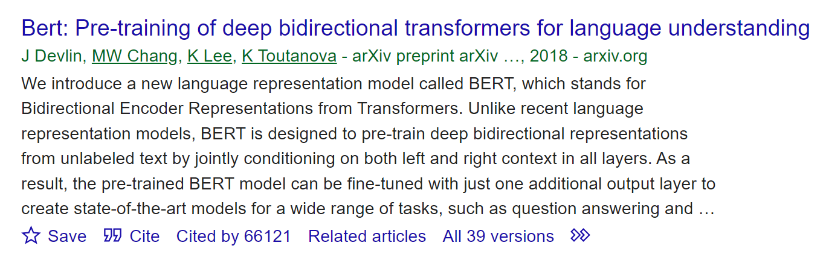
BERT

Slide 29
BERT
Unsupervised training:
masked word prediction
ex. “the [MASK] is on the mat”
next sentence prediction
ex. was “The cat is on the mat.” followed by “It is licking its paw.”?
Notes:
This first task is why we call BERT “bidirectional”: it gets to see words from both before and after the masked word that it is supposed to guess.

Slide 30
BERT
Training data:
Wikipedia + Brown Corpus of Standard American English
Notes:
Brown corpus: one million words of American English texts printed in 1961

Slide 31
BERT
Inputs:
Subwords, produced by a special tokenizer (called WordPiece)
ex. “These cats are overexcited” ->
“These”, “cat”, “s”, “are”, “over”, “ex”, “cite”, “d”
with pre-trained embeddings
Notes:
Also positional embeddings to encode where in the sequence the subword was located. For the next sentence task, there’s of course also a Segment embedding to tell the model whether a token came from sentence A or sentence B, so it understand that we are asking “was sentence A, consisting of these subwords in this order, followed by sentence B, with these subwords in this order?”

Slide 32
Being a [MASK] is hard
Notes:
BERT architecture: only a stack of encoders. The reason is that we aren’t doing tasks like translation here, where we also need a whole part of the model to translate what we just learned about the input sequence into an output sequence in another language. The output that we need to produce is pretty simple: what is the masked word. So a stack of decoders isn’t necessary.

Slide 33
BERT
BERT is meant to be fine-tuned:
Pre-train on the unsupervised masked word & next sentence tasks
Train a little more on specific tasks of interest
Performance:
General Language Understanding Evaluation (GLUE) score of 80.4%
Humans average 87.1% (Nangia & Bowman 2019)
Notes:
GLUE is an average of nine natural language tasks (question answering, sentiment analysis, paraphrasing)
BERT also has 93.3% accuracy on SQuAD dataset

Slide 34
GPT
Credits:
Shree, Priya. The Journey of Open AI GPT models
Notes:
https://dugas.ch/artificial_curiosity/GPT_architecture.html
https://medium.com/walmartglobaltech/the-journey-of-open-ai-gpt-models-32d95b7b7fb2

Slide 35
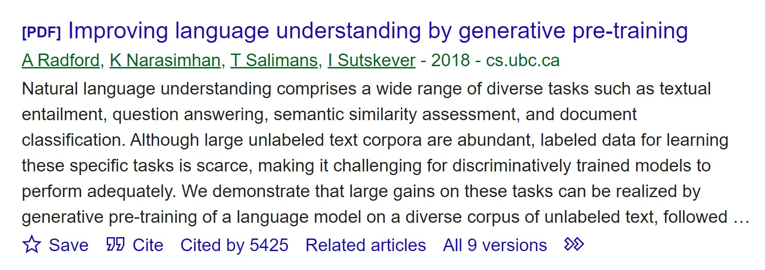
GPT-1
Notes:
GPT papers

Slide 36
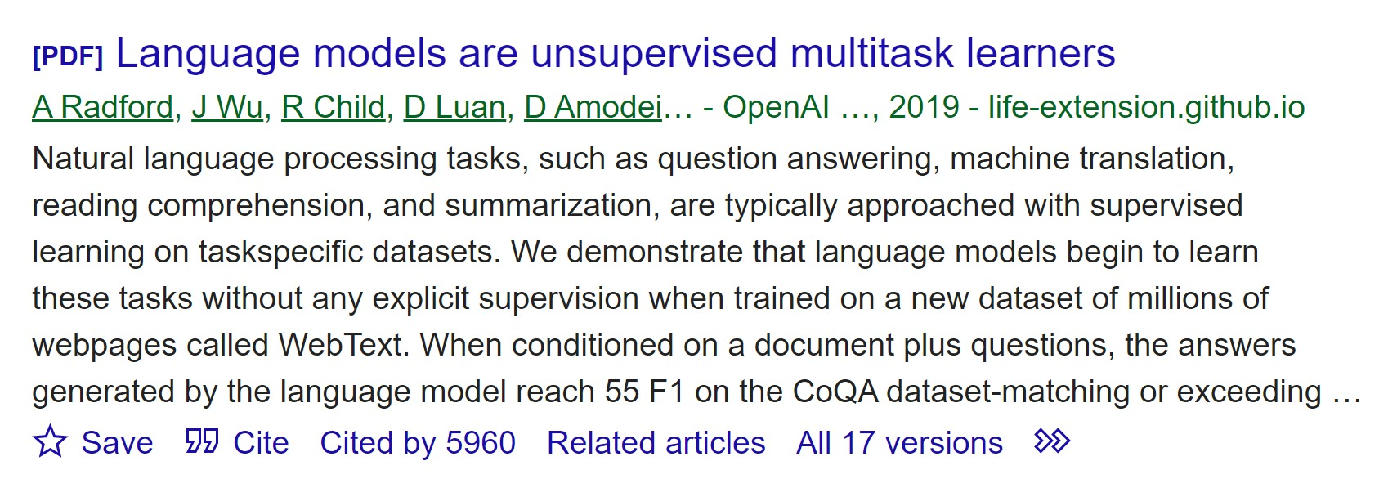
GPT-2
Notes:
GPT papers

Slide 37

GPT-3
Notes:
GPT papers

Slide 38
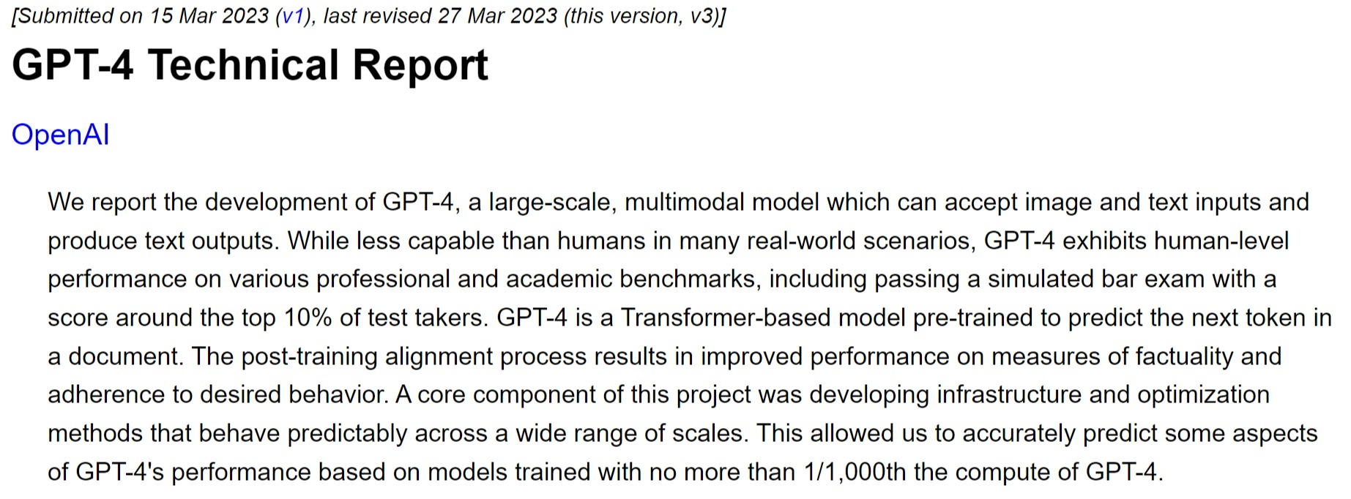
GPT-4
Notes:
No info here about model architecture, parameter count or training data. More of a product release, with performance metrics only

Slide 39
GPT
Unsupervised training:
Next word prediction
Ex. “The cat is…?”
Training data:
GPT-3: Common Crawl, WebText2, Books1, Books2 and Wikipedia
GPT-4: unknown
Notes:
This task is why we call GPT “autoregressive” (as opposed to BERT, which is “bidirectional”): it only gets to see the words in the sentence so far. And this is exactly what the model is used for after training: everything that GPT models can do is a form of next word prediction.
Common Crawl was collected via 8 years of scraping the internet. To see what’s in it: https://commoncrawl.github.io/cc-crawl-statistics/plots/domains
WebText2 is the content of every link that got more than three upvotes on Reddit
Books1 and books2 are lots of books, we don’t know which ones

Slide 40
GPT
Inputs:
Subwords, produced by a special tokenizer (called BPE)
without pre-trained embeddings
Notes:
And also, as with BERT, positional encodings.

Slide 41
I enjoy being a …
Notes:
GPT architecture: only a stack of decoders. The reason is that we are doing next-word prediction here, and not for example translation or text summarization, where we take in an input of one kind and need to create output of a whole different kind. It turns out that if you just feed in the input sentence in the form of subwords, you can just start decoding that into the information you need to make a next word prediction. To be honest, as we saw, the encoders and decoders in a transformer aren’t that different, and it seems to me that the big differences between BERT and GPT come from the tasks that they are trained on, their size (we’ll get back to that) and their training corpuses—not so much from their architecture.

Slide 42
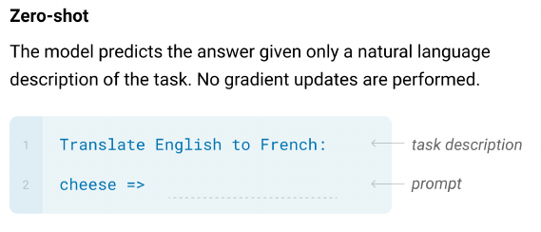
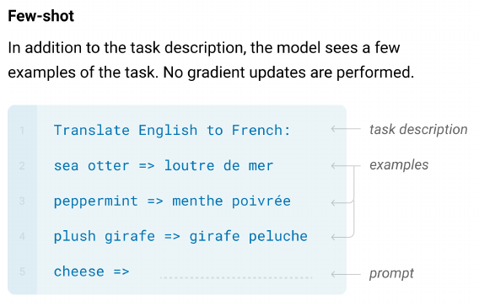
GPT
Notes:
GPT is not a model we fine-tune; it is always “just” trying to do the next-word prediction task that it was trained on. Because of the number of parameters GPT-3 and 4 have, and the humongous data sets they were trained on, its input sequences can be quite complicated. They can also include natural language descriptions of a task, with or without examples of what the model is supposed to do. And when it sees that input, it “just” tries to predict the first word of its answer, and the next, and the next, and so on.

Slide 43
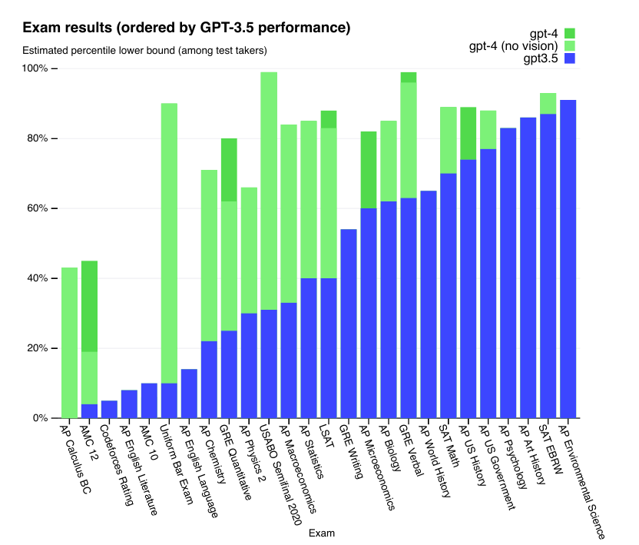

Slide 44
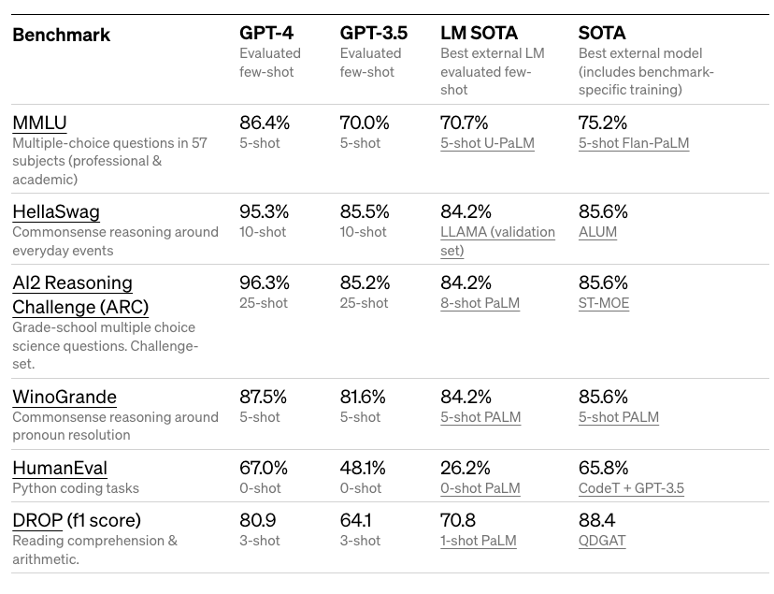
Notes:
https://arxiv.org/pdf/2303.08774.pdf

Slide 45
 | BERT large | GPT-4
Developed by | Google | OpenAI
Training task | Masked word and next sentence | Next word
# of parameters | 345 million | 1 trillion (rumor has it)
Good at | Being fine-tuned | Few-shot and zero-shot learning
Availability | Fully open source | Not available; interaction via API or GUI
Applications | Google search, voice assistant, … | Chatbot, Bing search, programming, producing (long) texts based on prompts, …
Notes:
GPT-3 had 175 billion parameters. The fact that BERT and GPT are good at completely different things is also the reason why we don’t usually try to compare their performances. In addition, we wouldn’t be able to tell whether the difference in performance comes from their architectures, the way they pre-process their inputs, or rather (more likely) from the amount of training data and the number of parameters they have. Sources:
https://medium.com/@10shubhamkedar10/gpt-vs-bert-12d108956260
https://360digitmg.com/blog/gpt-vs-bert
Rumor source: https://www.semafor.com/article/03/24/2023/the-secret-history-of-elon-musk-sam-altman-and-openai

Slide 46
GPT
New competitor: Google Bard chatbot
Out since February 2023, still improving
Based on Google’s proprietary LLM LaMDA
Trained on 1.6 trillion words (3.3 billion for BERT)
137 billion parameters

Slide 47
Large language model caveats
Credit:
Bender, Emily M., et al. On the Dangers of Stochastic Parrots: Can Language Models Be Too Big?

Slide 48
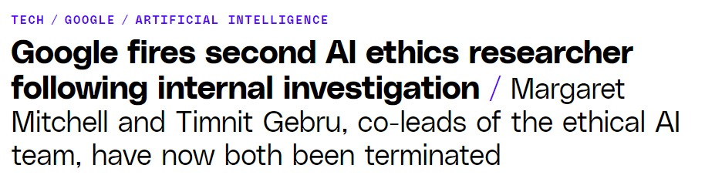
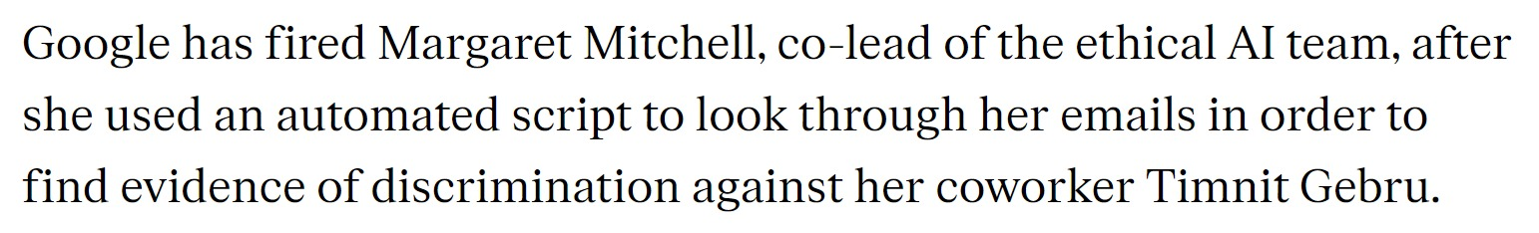
Notes:
https://www.theverge.com/2021/2/19/22292011/google-second-ethical-ai-researcher-fired

Slide 49
Large language model caveats
Caveat 1: large web text corpuses and bias
Produced by a skewed subset of people
Reproducing bias (stereotypes, hate speech)
Stuck in the past
Now: GPT-4 with unknown training data…
Notes:
Q: how do you imagine the authors of the average piece of content on the internet differs from the average human being? (or what do you remember reading about it in the parrots paper?) “67% of Reddit users in the United States are men, and 64% between ages 18 and 29. Similarly, recent surveys of Wikipedians find that only 8.8–15% are women or girls.”
Q: if a model was trained on content that is, say, five years old on average, how might it reflect values and language that has already changed since then?
https://venturebeat.com/ai/with-gpt-4-dangers-of-stochastic-parrots-remain-say-researchers-no-wonder-openai-ceo-is-a-bit-scared-the-ai-beat/

Slide 50
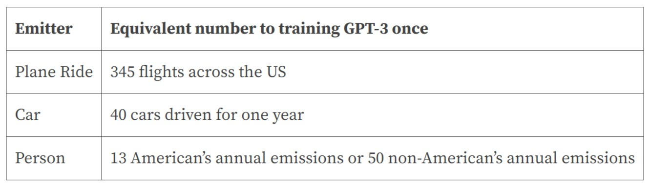
Large language model caveats
Caveat 2: environmental impact of training
Source: shrinkthatfootprint.com (most carbon intensive guess)
Notes:
A model is typically trained hundreds of times before a final version is released/published, both for perfecting the architecture and for tuning hyperparameters. Of course, these are guesstimates, and they depend very much on the energy sources being used to run the GPUs that train these models. It also means that the industry of training large language models is nowhere close in size to things like transport and food. On the other hand, LLMs are mostly luxury products used by the select few. And this table is only about emissions during training; we don’t really know what it costs to use these models once trained. NVIDIA estimated

Slide 51
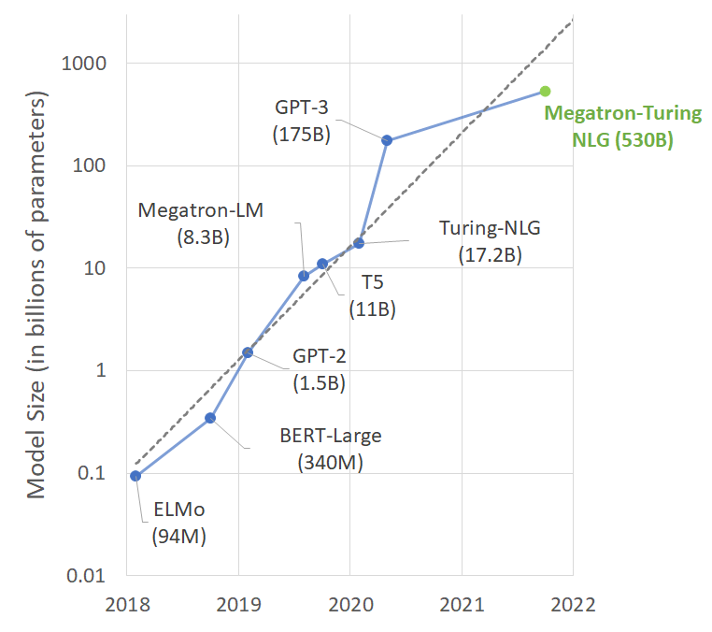
GPT-4?
Notes:
Note the exponential scale of the y-axis

Slide 52
Large language model caveats
Caveat 3: content moderation worker exploitation
Separate AI toxicity detection model filters output of ChatGPT
-> human labels needed
(not in Stochastic Parrots paper; recent development)
Notes:
https://venturebeat.com/ai/with-gpt-4-dangers-of-stochastic-parrots-remain-say-researchers-no-wonder-openai-ceo-is-a-bit-scared-the-ai-beat/

Slide 53

Large language model caveats
“The data labelers employed by Sama on behalf of OpenAI were paid a take-home wage of between around $1.32 and $2 per hour”
“The work’s traumatic nature eventually led Sama to cancel all its work for OpenAI […] eight months earlier than planned.”
Notes:
https://time.com/6247678/openai-chatgpt-kenya-workers/

Slide 54
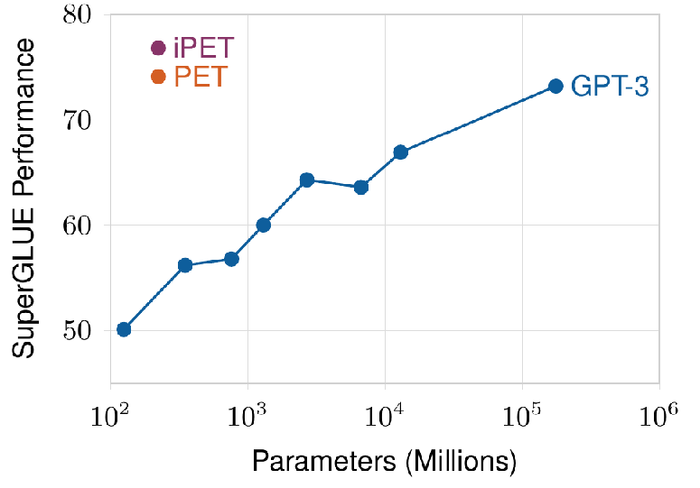
Large language model caveats
One solution: smaller models with curated training data
Schick & Schütze (2021)

Slide 55
Next class preview

Slide 56
Next class preview: content
Embedding models and tasks:
Skip-gram and CBOW
Word2vec, FastText and BERT embeddings
Problems with embeddings:
Bias
Instability

Slide 57
Next class preview: readings
Short sections from Hovy
Chapter from GRS
Rodriguez, P. L., & Spirling, A. (2022). Word embeddings: What works, what doesn’t, and how to tell the difference for applied research.
Notes:
So far, we have been treating embeddings only as a pre-processing step for models with language as input. So, they “work” if they improve performance of the model. But we will see that embeddings are also interesting in their own right, as summaries of meaning that we might like to study or use as variables in substantive analyses. The Rodriguez paper talks about those uses.

